Slide 1


Information Security Project Title
Secure File Distribution
System with Time-Limited
Access Control
Demonstrating Encryption, Authentication & Time-Based
Access Control for Sensitive Information Protection
Submitted by
Course
TALHA YASEEN
Information Security
BITF24M041
Academic Project 2026

Slide 2

Project Overview
Table of Contents
01
Problem Statement
02
Project Purpose
Understanding security challenges in modern file sharing platforms and the risks of uncontrolled access
Developing a secure solution with encryption and controlled access mechanisms for file distribution
03
System Objectives
04
Technical Implementation
Demonstrating core information security concepts: confidentiality, controlled access, and secure handling
Desktop-based system architecture with encryption, authentication, and time-based expiry mechanisms
05
Security Framework
06
Project Scope & Outcomes
Comprehensive security measures including encryption protocols, access control, and data protection
Prototype system boundaries, expected deliverables, and foundation for future enterprise development

Slide 3
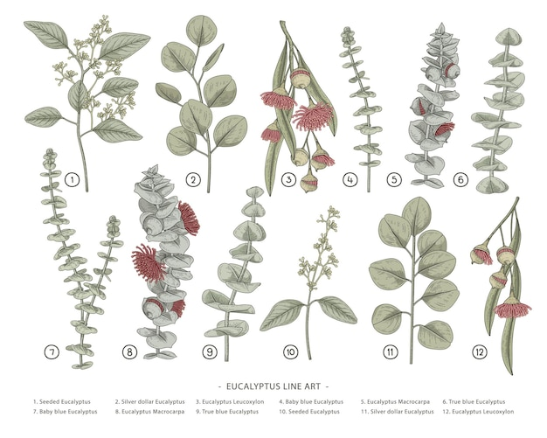
01
Problem Statement
Understanding the security challenges in modern file sharing and the critical need for controlled access mechanisms

Slide 4
01 / Problem Statement
The File Sharing Security Gap
Current Challenge
Common File Sharing Methods
In today's digital environment, files are frequently shared through email, cloud services, and messaging platforms without proper security controls. Once a file is shared, the sender often loses control over how long the recipient can access or distribute it.
Email Attachments
No access control or expiry
Cloud Storage Links
Limited revocation options
This lack of control creates significant vulnerabilities in data protection, as recipients may retain access indefinitely, share files with unauthorized parties, or store copies beyond the intended usage period.
Messaging Platforms
No encryption or expiry
Impact on Organizations
•
Intellectual property theft
•
Regulatory compliance violations
•
Reputational damage
Security Risks
•
Financial losses from data breaches
Unauthorized Sharing: Recipients can freely distribute files
Data Leakage: Sensitive information exposed beyond intended audience
No Expiry Control: Files remain accessible indefinitely
Lack of Audit Trail: No tracking of file access or distribution

Slide 5
02
Project Purpose
Developing a secure file distribution solution with encryption and time-limited access control mechanisms

Slide 6
02 / Project Purpose
System Purpose & Vision
Primary Purpose
System Benefits
The purpose of this project is to develop a Secure File Distribution System with Time-Limited Access Control that enhances file security through encryption and controlled access.
Sender Control
Maintain ownership after sharing
This system addresses the critical gap in current file sharing solutions by providing users with complete control over their shared files, ensuring that sensitive information remains protected even after distribution.
Automatic Expiry
Files become inaccessible after set time
Enhanced Privacy
Protection against unauthorized access
Compliance Ready
Core Capabilities
Supports data protection regulations
Target Users
File Encryption
Time-Limited Access
Access Control
XOR-ENC encryption before sharing
Customizable expiry periods
Password-based authentication
Business professionals sharing confidential documents
Healthcare providers transmitting patient data
Legal teams exchanging sensitive case files
Academic researchers sharing proprietary data
How It Works
1
2
3
4
Select File
Encrypt
Set Expiry
Share
Choose file to share
Apply encryption
Define access duration
Distribute securely

Slide 7
03
System Objectives
Demonstrating core information security concepts through practical implementation

Slide 8
03 / System Objectives
Project Objectives & Security Goals
Primary Objective
Demonstration Goals
The objective of this project is to demonstrate how encryption, authentication, and time-based access control can be used to protect sensitive information and prevent unauthorized file usage.
1
Encryption Implementation
Showcase file encryption using XOR-standard algorithms
2
Authentication Mechanisms
By implementing these three core security mechanisms, the system provides a comprehensive solution that addresses the major vulnerabilities in traditional file sharing methods.
Demonstrate secure user verification processes
3
Time-Based Access Control
Implement and test automatic file expiry functionality
4
Secure File Handling
Demonstrate proper secure file management practices
Security Principles Alignment
Confidentiality
Expected Learning Outcomes
Encryption ensures only authorized parties can access file contents
Authentication
Practical understanding of cryptographic principles
Password verification confirms recipient identity before access
Experience with access control system design
Controlled Access
Knowledge of secure software development practices
Time limits prevent indefinite access to sensitive files
Ability to implement time-based security mechanisms

Slide 9
04
Technical Implementation
Desktop-based system architecture with comprehensive security components

Slide 10
04 / Technical Implementation
System Architecture & Components
System Overview
System Workflow
This project will implement a desktop-based system that allows users to securely share files with restricted access time. The system provides a comprehensive solution for secure file distribution with XOR based encryption and access control mechanisms.
1
File Selection
User selects file to share
The application will be developed as a standalone desktop application, ensuring that all file processing occurs locally without relying on external cloud services or internet connectivity for core security functions.
2
Encryption Process
File encrypted with XOR-ENC
3
Access Configuration
Set password and expiry time
Core System Components
File Encryption Module
Authentication System
4
Secure Distribution
XOR base encryption/decryption
Password-based verification
Share encrypted file package
Time-Based Expiry
Secure File Handler
Access & Expiry
Automatic access revocation
Safe file operations
5
Recipient authenticates and accesses
Technical Stack
Key Features
C++
XOR-ENC
XOR-Cipher
CLI
Git-Hub
Local file processing
No cloud dependency
Cross-platform compatibility
User-friendly interface

Slide 11
05 / Security Framework
Security Framework & Core Features
Security Framework
Feature Comparison
The project will mainly focus on demonstrating core information security concepts such as confidentiality, controlled access, and secure file handling. The security framework is designed to provide comprehensive protection throughout the file lifecycle.
Feature | Our System | Traditional
File Encryption
Password Protection
Time-Limited Access
Local Processing
No Cloud Dependency
Each security mechanism is carefully selected to address specific threats while maintaining usability and performance for end users.
Security Mechanisms
Data Protection Measures
Confidentiality
XOR-ENC
Industry-standard encryption ensures file contents remain secret
End-to-End Encryption: Files encrypted before leaving sender's device
Secure Key Management: Password-derived keys with salt
Authentication
XOR
Automatic Expiry: Time-based access revocation
Password-based key derivation with salt for secure verification
Integrity Verification: Checksum validation for file integrity
Access Control
Time-Based
Automatic expiry mechanism prevents indefinite access

Slide 12
Project Summary
Project Scope & Expected Outcomes
Project Scope
Expected Outcomes
This project will be developed as a prototype system focusing on demonstrating core information security concepts. It will not include advanced cloud integration or enterprise-level security features.
Functional Secure File Distribution System: Working prototype with encryption, authentication, and time-based access control
Demonstration of Security Principles: Practical showcase of confidentiality, controlled access, and secure file handling
The scope is intentionally focused to ensure thorough implementation and demonstration of fundamental security principles within an academic project timeline.
Foundation for Future Development: Extensible architecture supporting future enterprise features and cloud integration
Project Deliverables
Desktop System
Documentation
Test Results
Demo Presentation
Functional prototype
Technical & user guides
Security validation
System showcase
"Securing Information, One File at a Time"
TALHA YASEEN | BITF24M041 | Information Security Project 2026

